Slide 1
Phase 3 Report.
Team: Online Trading Cards
By John Katumo, Daniel Ortiz and Nathaniel Clayton.

Slide 2
Objective
Online Trading Cards (oTc) is a website that creates and distributes virtual trading cards of your favorite baseball players. When a collector wants to start building their collection, they purchase a ten pack of virtual cards and they receive 10 virtual cards to put in their collections. Each card will have the player’s latest stats. Unlike physical trading cards, our player stats are updated every day so your card never goes out of date. It’s bringing a childhood pastime into the twenty first century.

Slide 3
End users
The end users of our service will be sports fans and sports card collectors who want to create a virtual card collection to share and trade with friends.

Slide 4
Data sources
For our data source, we have decided to use the website www.mySportsFeeds.com. This website provides an API (Application Programming Interface) that will be capable of retrieving the player and team data that is necessary for creating sports trading cards.

Slide 5
Business rules
Every player must have a name, position, jersey number, age, height, weight and if the player is a rookie.
A player’s age, jersey number, height and weight cannot be negative.
A collector may have many collections but a collection belongs to only one collector.
A collection may have many cards, but a single card belongs in only one collection.
Each card represents a single player, but a player may be represented on many cards.
A team may include one or more players and players are only allowed to play for one team.

Slide 6
Business rules cont.
For every collector, we must store their name, age, and a valid e-mail address.
A collector must be at least 13 years of age.
Every collection must contain a name, description, and number of cards (no less than zero) in the collection.
Every card must contain its creation date, name, and description.
The names and descriptions for cards and collections are defined by the collector after creation.
We must store the name, city and abbreviation for every team.
Team abbreviations must be 3 characters in length.

Slide 7
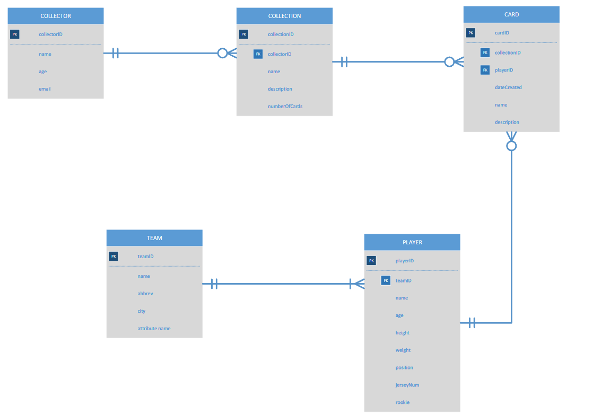
ERD

Slide 8
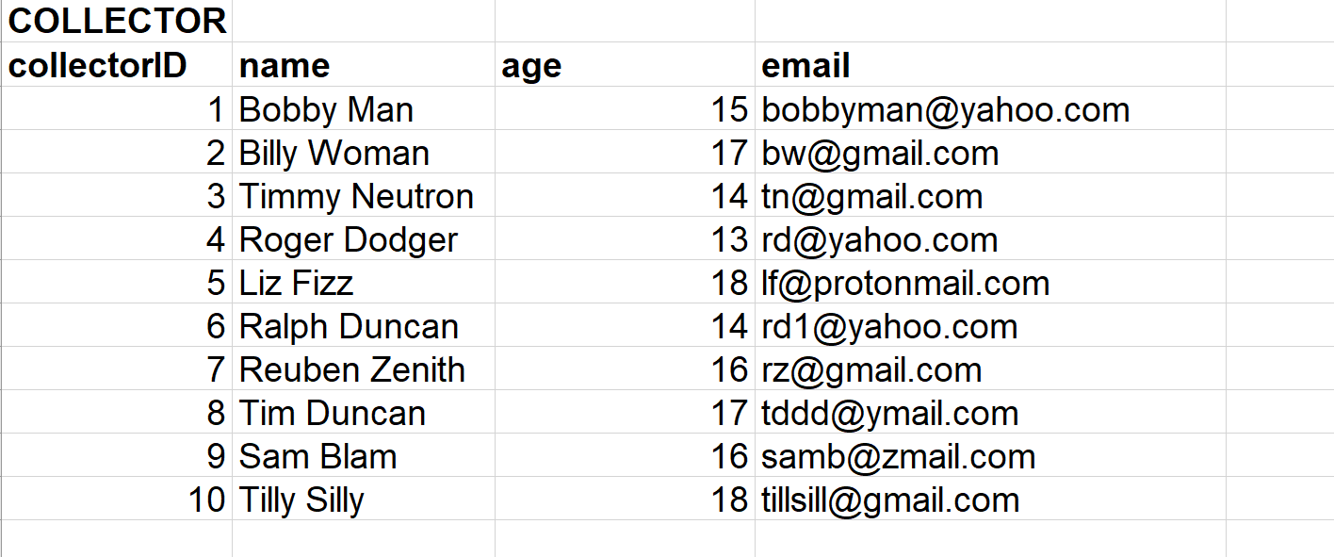

Slide 9
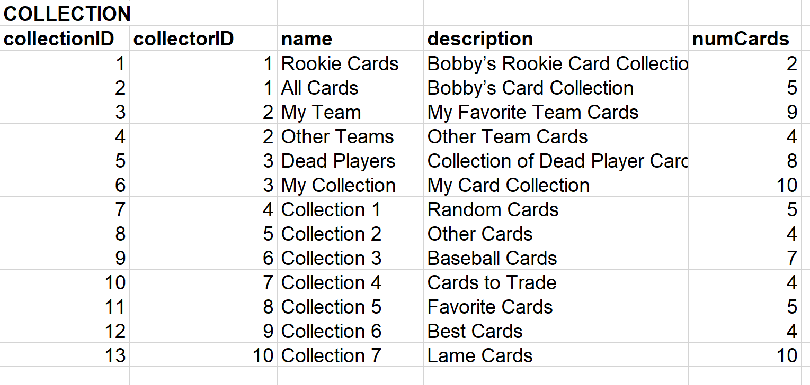

Slide 10
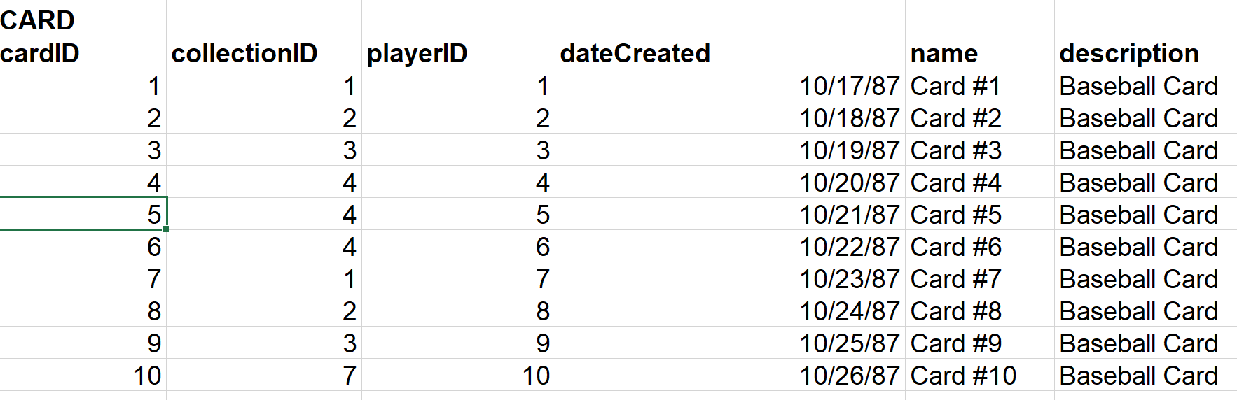

Slide 11
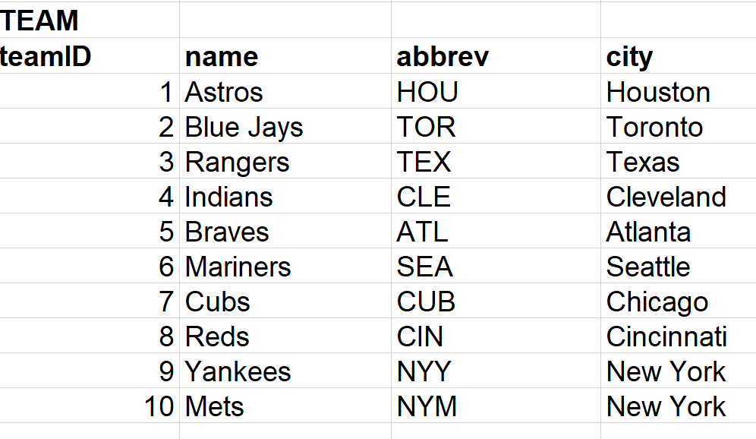

Slide 12
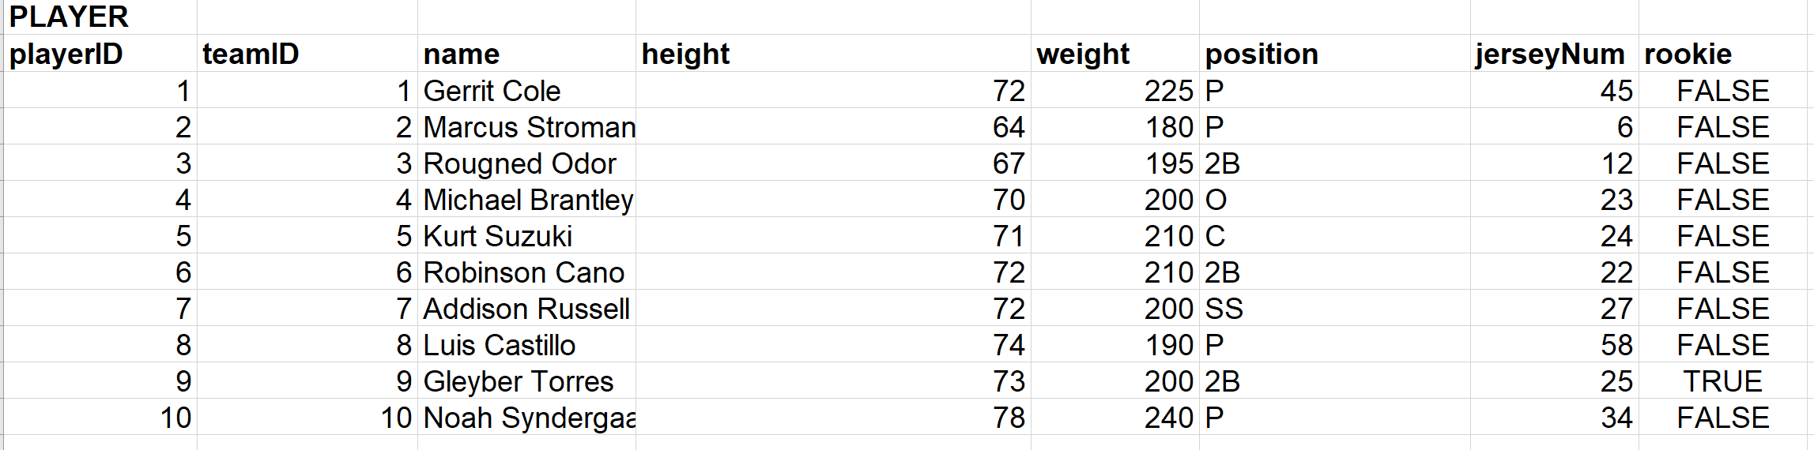

Slide 13
1NF
All the tables are in one 1NF because there is no nested attributes, or repeated attributes.
They also have their primary keys.
COLLECTOR (Collector ID, Name, Age, Email)
Primary Key: Collector_ID
COLLECTION (Collection_ID, Collector_ID, Name, Description, NumCards)
Primary Keys: Collection_ID, Collector_ID
Foreign Key: Collector_ID
CARD (Card_ID, Collection_ID, Collector_ID, DateCreated, Name, Description)
Primary Keys: Card_ID, Collection_ID, Collector_ID
Foreign Key: Collection_ID, Collector_ID
TEAM (Team_ID, Name, Abbrev, City)
Primary Key: Team_ID
PLAYER (Player_ID, Team_ID, Name, Height, Weight, Position, JerseyNum, Rookie)
Primary Keys: Player_ID, Team_ID
Foreign Key: Team_ID

Slide 14
2NF
The tables are in 2NF because there are no partial dependencies
COLLECTOR (Collector ID, Name, Age, Email)
Primary Key: Collector_ID
COLLECTION (Collection_ID, Collector_ID, Name, Description, NumCards)
Primary Keys: Collection_ID, Collector_ID
Foreign Key: Collector_ID
CARD (Card_ID, Collection_ID, Collector_ID, DateCreated, Name, Description)
Primary Keys: Card_ID, Collection_ID, Collector_ID
Foreign Key: Collection_ID, Collector_ID
TEAM (Team_ID, Name, Abbrev, City)
Primary Key: Team_ID
PLAYER (Player_ID, Team_ID, Name, Height, Weight, Position, JerseyNum, Rookie)
Primary Keys: Player_ID, Team_ID
Foreign Key: Team_ID

Slide 15
3NF
All the tables are in 3NF because there is no transitive dependencies.
COLLECTOR (Collector ID, Name, Age, Email)
Primary Key: Collector_ID
COLLECTION (Collection_ID, Collector_ID, Name, Description, NumCards)
Primary Keys: Collection_ID, Collector_ID
Foreign Key: Collector_ID
CARD (Card_ID, Collection_ID, Collector_ID, DateCreated, Name, Description)
Primary Keys: Card_ID, Collection_ID, Collector_ID
Foreign Key: Collection_ID, Collector_ID
TEAM (Team_ID, Name, Abbrev, City)
Primary Key: Team_ID
PLAYER (Player_ID, Team_ID, Name, Height, Weight, Position, JerseyNum, Rookie)
Primary Keys: Player_ID, Team_ID
Foreign Key: Team_ID

Slide 16
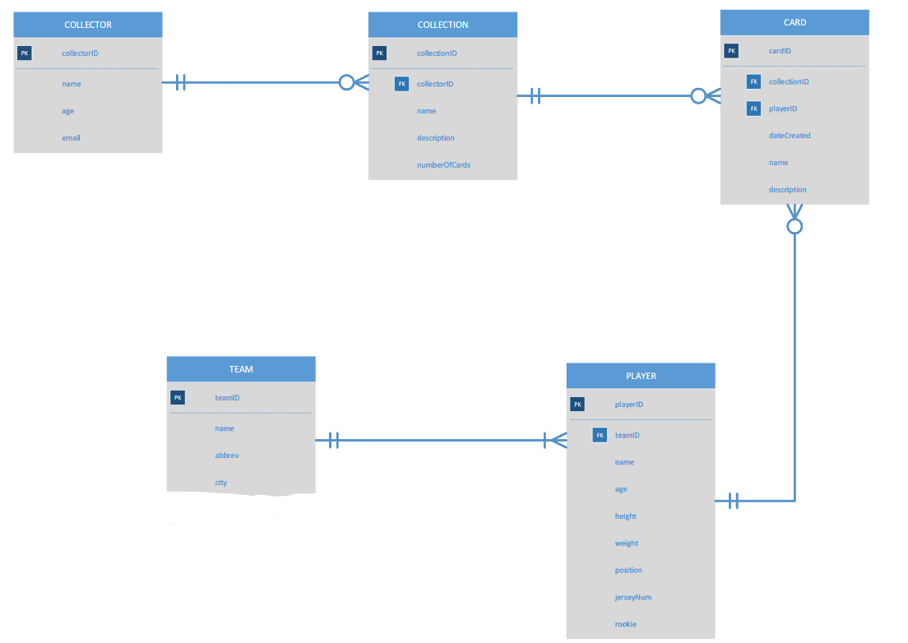
Final ERD.

Slide 17
Data Table Location
The database tables are located in Nathan Clayton’s folder
All tables were created under nclayton account

Slide 18
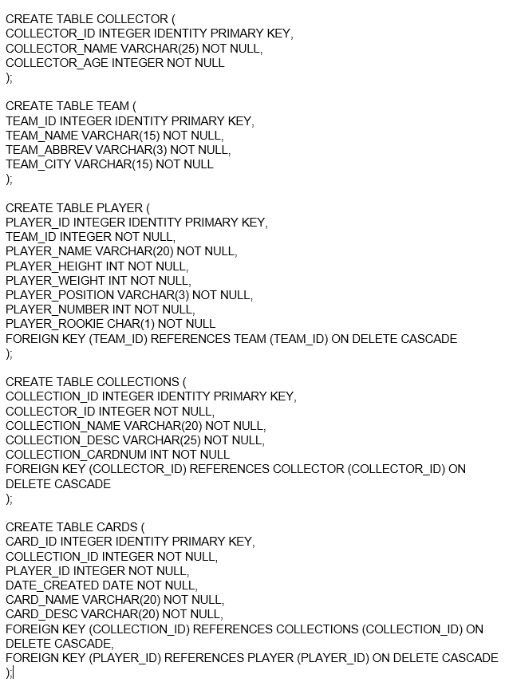
CREATE TABLE SQL

Slide 19
INSERT TABLE CARDS
INSERT INTO CARDS VALUES (1, 105, '11/14/2016', 'Card 1', 'This guy...'); INSERT INTO CARDS VALUES (2, 41, '11/16/2014', 'Card 22', 'Who?'); INSERT INTO CARDS VALUES (2, 10, '11/12/2014', 'Card 99', 'slob'); INSERT INTO CARDS VALUES (3, 75, '11/13/2013', 'Card 78', 'rookie'); INSERT INTO CARDS VALUES (4, 25, '11/11/2014', 'Card 66', 'best card'); INSERT INTO CARDS VALUES (3, 19, '11/10/2013', 'Card 74', 'trade soon'); INSERT INTO CARDS VALUES (2, 85, '11/19/2010', 'Card 44', 'my team'); INSERT INTO CARDS VALUES (1, 17, '11/14/2017', 'Card 321', 'fav player'); INSERT INTO CARDS VALUES (2, 11, '11/12/2018', 'Card 498', 'Tuff'); INSERT INTO CARDS VALUES (14, 17, '11/8/2018', 'Card 975', 'Good'); INSERT INTO CARDS VALUES (15, 45, '11/8/2018', 'Card 435', 'TAverage'); INSERT INTO CARDS VALUES (6, 65, '11/7/2015', 'Card 498', 'This guy sucks'); INSERT INTO CARDS VALUES (7, 16, '01/18/2015', 'Card 1', 'No good player'); INSERT INTO CARDS VALUES (8, 95, '02/18/2015', 'Card 77', 'Weak sauce'); INSERT INTO CARDS VALUES (9, 75, '03/18/2015', 'Card 99', 'Lame dude'); INSERT INTO CARDS VALUES (10, 35, '04/18/2015', 'Card 984', 'Best player'); INSERT INTO CARDS VALUES (11, 102, '7/18/2015', 'Card 1235', 'Homerun winner');

Slide 20
INSERT TABLE COLLECTIONS
INSERT INTO COLLECTIONS VALUES (1, 'Favorites', 'My Favorite Cards', 12); INSERT INTO COLLECTIONS VALUES (2, 'Junk Cards', 'These are garbage', 18); INSERT INTO COLLECTIONS VALUES (3, 'Rookies', 'All rookie cards', 16); INSERT INTO COLLECTIONS VALUES (4, 'My Team', 'These are all my team', 12); INSERT INTO COLLECTIONS VALUES (5, 'MLB', 'MLB Cards', 9); INSERT INTO COLLECTIONS VALUES (6, 'My Fav', 'Favorite Card Ever', 1); INSERT INTO COLLECTIONS VALUES (7, 'Temp', 'Temp Storage', 7); INSERT INTO COLLECTIONS VALUES (8, 'Wasted', 'Wasted money cards', 7); INSERT INTO COLLECTIONS VALUES (9, 'Crap', 'Crappy Cards', 8); INSERT INTO COLLECTIONS VALUES (10, 'Top Cards', 'These are topps', 6); INSERT INTO COLLECTIONS VALUES (11, 'Lame Cards', 'Crappy cards', 4); INSERT INTO COLLECTIONS VALUES (12, 'the best', 'the best cards ever', 45); INSERT INTO COLLECTIONS VALUES (13, 'no names', 'who are these ppl', 13); INSERT INTO COLLECTIONS VALUES (14, 'all star', 'all star players', 45); INSERT INTO COLLECTIONS VALUES (15, 'trash', 'trash players only', 68); INSERT INTO COLLECTIONS VALUES (16, 'whole collection', 'every card i have', 78);

Slide 21
INSERT TABLE COLLECTOR
INSERT INTO COLLECTOR VALUES ('Hank Hill', 45); INSERT INTO COLLECTOR VALUES ('Bobby Hill', 19); INSERT INTO COLLECTOR VALUES ('Cotton Hill', 16); INSERT INTO COLLECTOR VALUES ('Peggy Hill', 75); INSERT INTO COLLECTOR VALUES ('Lou Ann Hill', 13); INSERT INTO COLLECTOR VALUES ('Steve Urkel', 15); INSERT INTO COLLECTOR VALUES ('Laura Winslow', 14); INSERT INTO COLLECTOR VALUES ('Carl Winslow', 14); INSERT INTO COLLECTOR VALUES ('Eddie Winslow', 19); INSERT INTO COLLECTOR VALUES ('Waldo Faldo', 17); INSERT INTO COLLECTOR VALUES ('Danny Tanner', 22); INSERT INTO COLLECTOR VALUES ('DJ Tanner', 36); INSERT INTO COLLECTOR VALUES ('David Hader', 84); INSERT INTO COLLECTOR VALUES ('Scuba Steve', 40); INSERT INTO COLLECTOR VALUES ('Billy Madison', 15); INSERT INTO COLLECTOR VALUES ('Tim Allen', 13);

Slide 22
INSERT TABLE TEAM
INSERT INTO TEAM VALUES ('Orioles','BAL', 'Baltimore'); INSERT INTO TEAM VALUES ('Red Sox','BOS', 'Boston'); INSERT INTO TEAM VALUES ('White Sox','SOX', 'Chicago'); INSERT INTO TEAM VALUES ('Indians','CLE', 'Cleveland'); INSERT INTO TEAM VALUES ('Tigers','DET', 'Detroit'); INSERT INTO TEAM VALUES ('Astros','HOU', 'Houston'); INSERT INTO TEAM VALUES ('Royals','KC', 'Kansas City'); INSERT INTO TEAM VALUES ('Angels','LAA', 'Los Angeles'); INSERT INTO TEAM VALUES ('Twins','MIN', 'Minnesota'); INSERT INTO TEAM VALUES ('Yankees','NYY', 'New York'); INSERT INTO TEAM VALUES ('Athletics','OAK', 'Oakland'); INSERT INTO TEAM VALUES ('Mariners','SEA', 'Seattle'); INSERT INTO TEAM VALUES ('Rays','TB', 'Tampa Bay'); INSERT INTO TEAM VALUES ('Rangers','TX', 'Texas'); INSERT INTO TEAM VALUES ('Blue Jays','TOR', 'Toronto');

Slide 23
INSERT TABLE PLAYERS
INSERT INTO PLAYER VALUES (1, 'Donnie Hart', 71, 180, 'RP', 57, 'F'); INSERT INTO PLAYER VALUES (1, 'Paul Fry', 72, 190, 'RP', 51, 'F'); INSERT INTO PLAYER VALUES (1, 'Andrew Susac', 73, 215, 'C', 27, 'F'); INSERT INTO PLAYER VALUES (1, 'Breyvic Valera', 71, 160, '2B', 28, 'F'); INSERT INTO PLAYER VALUES (1, 'Renato Nunez', 73, 200, '3B', 39, 'F'); INSERT INTO PLAYER VALUES (1, 'Credric Mullins', 68, 175, 'CF', 3, 'T'); INSERT INTO PLAYER VALUES (1, 'DJ Stewart', 72, 230, 'RF', 62, 'F'); INSERT INTO PLAYER VALUES (2, 'Matt Barnes', 76, 210, 'RP', 32, 'F'); INSERT INTO PLAYER VALUES (2, 'Ryan Brasier', 72, 205, 'RP', 70, 'F'); INSERT INTO PLAYER VALUES (2, 'Sandy Leon', 70, 225, 'C', 3, 'F'); INSERT INTO PLAYER VALUES (2, 'Xander Bogaerts', 73, 210, 'SS', 2, 'F'); INSERT INTO PLAYER VALUES (2, 'Michael Chavis', 70, 190, 'SS', 39, 'F'); INSERT INTO PLAYER VALUES (2, 'Andrew Benintendi', 70, 170, 'LF', 16, 'T'); INSERT INTO PLAYER VALUES (2, 'Mookie Betts', 69, 180, 'CF', 50, 'F'); INSERT INTO PLAYER VALUES (3, 'Manny Banuelos', 70, 215, 'RP', 90, 'F'); INSERT INTO PLAYER VALUES (3, 'Aaron Bummer', 75, 200, 'RP', 39, 'F'); INSERT INTO PLAYER VALUES (3, 'Welington Castillo', 70, 220, 'C', 21, 'F'); INSERT INTO PLAYER VALUES (3, 'Jose Abreu', 75, 255, '1B', 79, 'F'); INSERT INTO PLAYER VALUES (3, 'Tim Anderson', 73, 185, 'SS', 7, 'F'); INSERT INTO PLAYER VALUES (3, 'Ryan Cordell', 76, 195, 'CF', 49, 'T'); INSERT INTO PLAYER VALUES (3, 'Nicky Delmonico', 74, 230, 'LF', 30, 'F');

Slide 24
INSERT PLAYERS CONT.
INSERT INTO PLAYER VALUES (4, 'Cody Anderson', 76, 240, 'RP', 56, 'F'); INSERT INTO PLAYER VALUES (4, 'Trevor Bauer', 73, 190, 'SP', 47, 'F'); INSERT INTO PLAYER VALUES (4, 'Eric Haase', 70, 180, 'C', 38, 'F'); INSERT INTO PLAYER VALUES (4, 'Yonder Alonso', 73, 230, '1B', 17, 'F'); INSERT INTO PLAYER VALUES (4, 'Yandy Diaz', 74, 185, '3b', 36, 'F'); INSERT INTO PLAYER VALUES (4, 'Greg Allen', 72, 175, 'CF', 1, 'T'); INSERT INTO PLAYER VALUES (4, 'Nicky Delmonico', 74, 195, 'CF', 22, 'F'); INSERT INTO PLAYER VALUES (5, 'Victor Alcantara', 74, 190, 'RP', 58, 'F'); INSERT INTO PLAYER VALUES (5, 'Sandy Baez', 74, 180, 'RP', 62, 'F'); INSERT INTO PLAYER VALUES (5, 'Grayson Greiner', 78, 220, 'C', 17, 'F'); INSERT INTO PLAYER VALUES (5, 'Miguel Cabrera', 76, 240, '1B', 24, 'F'); INSERT INTO PLAYER VALUES (5, 'Jeimer Candelario', 73, 210, '3B', 46, 'F'); INSERT INTO PLAYER VALUES (5, 'Nicholas Castellanos', 76, 210, 'RF', 9, 'T'); INSERT INTO PLAYER VALUES (5, 'Brandon Dixon', 73, 213, 'CF', 4, 'F'); INSERT INTO PLAYER VALUES (6, 'Rogelio Armenteros', 73, 215, 'RP', 95, 'F'); INSERT INTO PLAYER VALUES (6, 'Gerrit Cole', 76, 225, 'SP', 45, 'F'); INSERT INTO PLAYER VALUES (6, 'Robinson Chirinos', 73, 210, 'C', 61, 'F'); INSERT INTO PLAYER VALUES (6, 'Jose Altuve', 66, 165, '2B', 27, 'F'); INSERT INTO PLAYER VALUES (6, 'Alex Bregman', 72, 180, '3B', 2, 'F'); INSERT INTO PLAYER VALUES (6, 'Jake Marisnick', 76, 220, 'CF', 6, 'T');

Slide 25
INSERT PLAYERS CONT.
INSERT INTO PLAYER VALUES (6, 'Brandon Dixon', 74, 195, 'RF', 22, 'F'); INSERT INTO PLAYER VALUES (7, 'Scott Barlow', 75, 175, 'RP', 58, 'F'); INSERT INTO PLAYER VALUES (7, 'Scott Blewett', 78, 210, 'SP', 35, 'F'); INSERT INTO PLAYER VALUES (7, 'Cam Gallagher', 75, 230, 'C', 36, 'F'); INSERT INTO PLAYER VALUES (7, 'Cheslor Cuthbert', 73, 190, '3B', 19, 'F'); INSERT INTO PLAYER VALUES (7, 'Hunter Dozier', 76, 220, '3B', 17, 'F'); INSERT INTO PLAYER VALUES (7, 'Jorge Bonifacio', 73, 195, 'RF', 38, 'T'); INSERT INTO PLAYER VALUES (7, 'Brian Goodwin', 72, 200, 'CF', 25, 'F'); INSERT INTO PLAYER VALUES (8, 'Miguel Almonte', 74, 210, 'RP', 49, 'F'); INSERT INTO PLAYER VALUES (8, 'Jose Alvarez', 71, 190, 'RP', 48, 'F'); INSERT INTO PLAYER VALUES (8, 'Francisco Arcia', 71, 195, 'C', 37, 'F'); INSERT INTO PLAYER VALUES (8, 'Kaleb Cowart', 75, 225, '3B', 22, 'F'); INSERT INTO PLAYER VALUES (8, 'Zack Cozart', 70, 204, '3B', 7, 'F'); INSERT INTO PLAYER VALUES (8, 'Kole Calhoun', 70, 205, 'RF', 56, 'T'); INSERT INTO PLAYER VALUES (8, 'Michael Hermosillo', 71, 190, 'CF', 59, 'F'); INSERT INTO PLAYER VALUES (9, 'Jose Berrios', 72, 185, 'SP', 17, 'F'); INSERT INTO PLAYER VALUES (9, 'John Curtiss', 76, 200, 'RP', 27, 'F'); INSERT INTO PLAYER VALUES (9, 'Willians Astudillo', 69, 185, 'C', 64, 'F'); INSERT INTO PLAYER VALUES (9, 'Ehire Adrianza', 75, 225, 'SS', 16, 'F'); INSERT INTO PLAYER VALUES (9, 'Luis Arraez', 70, 155, '2B', 35, 'F');

Slide 26
INSERT PLAYERS CONT.
INSERT INTO PLAYER VALUES (9, 'Byron Buxton', 74, 190, 'CF', 25, 'T'); INSERT INTO PLAYER VALUES (9, 'Jake Cave', 72, 180, 'CF', 60, 'F'); INSERT INTO PLAYER VALUES (10, 'Chance Adams', 72, 215, 'SP', 43, 'F'); INSERT INTO PLAYER VALUES (10, 'Dellin Betances', 80, 265, 'RP', 68, 'F'); INSERT INTO PLAYER VALUES (10, 'Kyle Higashioka', 72, 200, 'C', 66, 'F'); INSERT INTO PLAYER VALUES (10, 'Hanser Alberto', 71, 175, 'SS', 2, 'F'); INSERT INTO PLAYER VALUES (10, 'Miguel Andujar', 70, 155, '3B', 41, 'F'); INSERT INTO PLAYER VALUES (10, 'Jacoby Ellsbury', 73, 195, 'CF', 22, 'T'); INSERT INTO PLAYER VALUES (10, 'Jake Cave', 73, 190, 'LF', 77, 'F'); INSERT INTO PLAYER VALUES (11, 'Tanner Anderson', 74, 195, 'RP', 52, 'F'); INSERT INTO PLAYER VALUES (11, 'Chris Bassit', 77, 210, 'SP', 40, 'F'); INSERT INTO PLAYER VALUES (11, 'Josh Phegley', 70, 225, 'C', 19, 'F'); INSERT INTO PLAYER VALUES (11, 'Franklin Barreto', 70, 190, '2B', 1, 'F'); INSERT INTO PLAYER VALUES (11, 'Mark Canha', 73, 200, '1B', 20, 'F'); INSERT INTO PLAYER VALUES (11, 'Khris Davis', 70, 195, 'LF', 2, 'T'); INSERT INTO PLAYER VALUES (11, 'Dustin Fowler', 72, 185, 'CF', 77, 'F'); INSERT INTO PLAYER VALUES (12, 'Ruben Alaniz', 76, 219, 'RP', 80, 'F'); INSERT INTO PLAYER VALUES (12, 'Dan Altavilla', 71, 200, 'RP', 53, 'F'); INSERT INTO PLAYER VALUES (12, 'David Freitas', 75, 225, 'C', 36, 'F'); INSERT INTO PLAYER VALUES (12, 'JP Crawford', 74, 180, 'SS', 2, 'F');

Slide 27
INSERT PLAYERS CONT.
INSERT INTO PLAYER VALUES (12, 'Dee Gordon', 71, 170, '2B', 9, 'F'); INSERT INTO PLAYER VALUES (12, 'John Andreoli', 73, 210, 'RF', 34, 'T'); INSERT INTO PLAYER VALUES (12, 'Braden Bishop', 73, 190, 'CF', 82, 'F'); INSERT INTO PLAYER VALUES (13, 'Jose Alvarado', 74, 245, 'RP', 46, 'F'); INSERT INTO PLAYER VALUES (13, 'Anthony Banda', 74, 190, 'SP', 53, 'F'); INSERT INTO PLAYER VALUES (13, 'Nick Ciuffo', 73, 205, 'C', 19, 'F'); INSERT INTO PLAYER VALUES (13, 'Willy Adames', 73, 180, 'SS', 1, 'F'); INSERT INTO PLAYER VALUES (13, 'Christian Arroyo', 73, 180, 'SS', 21, 'F'); INSERT INTO PLAYER VALUES (13, 'Guillermo Heredia', 70, 180, 'LF', 5, 'T'); INSERT INTO PLAYER VALUES (13, 'Kevin Kiermaier', 73, 215, 'CF', 39, 'F'); INSERT INTO PLAYER VALUES (14, 'Jesse Chavez', 74, 175, 'RP', 43, 'F'); INSERT INTO PLAYER VALUES (14, 'Alex Claudio', 75, 180, 'RP', 58, 'F'); INSERT INTO PLAYER VALUES (14, 'Jeff Mathis', 72, 205, 'C', 2, 'F'); INSERT INTO PLAYER VALUES (14, 'Elvis Andrus', 72, 200, 'SS', 1, 'F'); INSERT INTO PLAYER VALUES (14, 'Joey Gallo', 77, 235, '3B', 13, 'F'); INSERT INTO PLAYER VALUES (14, 'Willie Calhoun', 68, 187, 'LF', 5, 'T'); INSERT INTO PLAYER VALUES (14, 'Shin-Soo Choo', 71, 210, 'RF', 17, 'F'); INSERT INTO PLAYER VALUES (15, 'Danny Barnes', 73, 195, 'RP', 24, 'F'); INSERT INTO PLAYER VALUES (15, 'Joe Biagini', 77, 240, 'RP', 31, 'F'); INSERT INTO PLAYER VALUES (15, 'Danny Jansen', 74, 225, 'C', 9, 'F');

Slide 28
INSERT PLAYERS CONT.
INSERT INTO PLAYER VALUES (15, 'Brandon Drury', 74, 210, '3B', 10, 'F'); INSERT INTO PLAYER VALUES (15, 'Lourdes Gurriel', 74, 185, '2B', 13, 'F'); INSERT INTO PLAYER VALUES (15, 'Anthony Alford', 73, 215, 'CF', 30, 'T'); INSERT INTO PLAYER VALUES (15, 'Jonathan Davis', 68, 190, 'CF', 67, 'F');

Slide 29
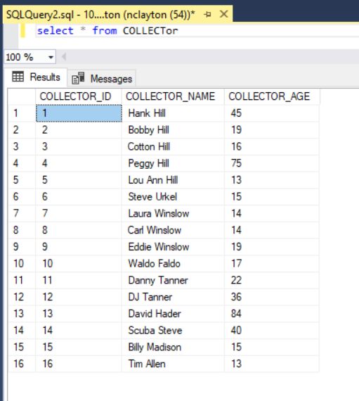
Collector table.

Slide 30
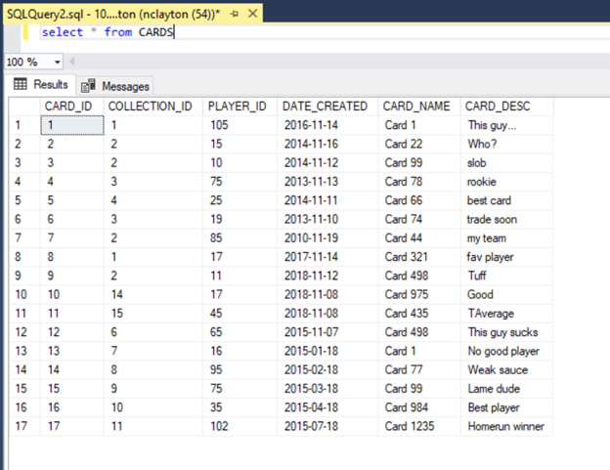
Cards table

Slide 31
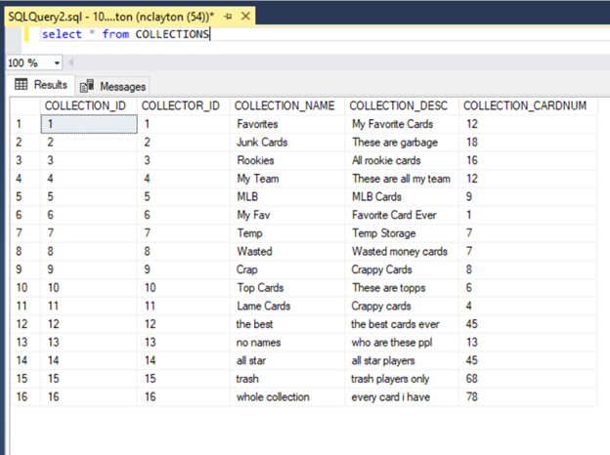
Collections table

Slide 32
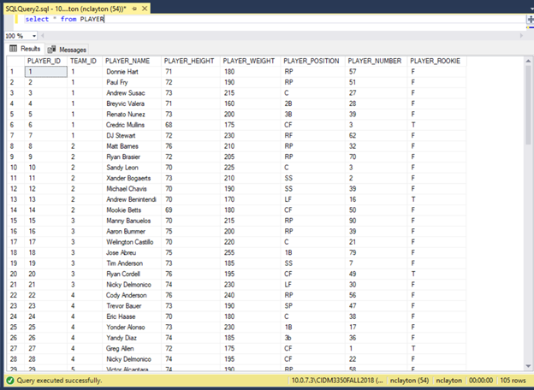
Player table

Slide 33
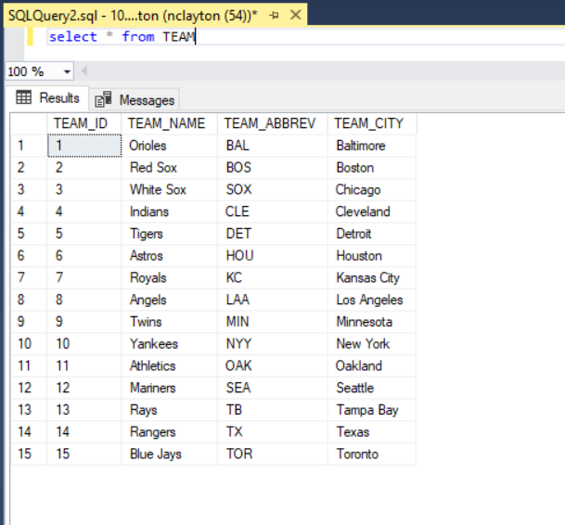
Team table

Slide 34
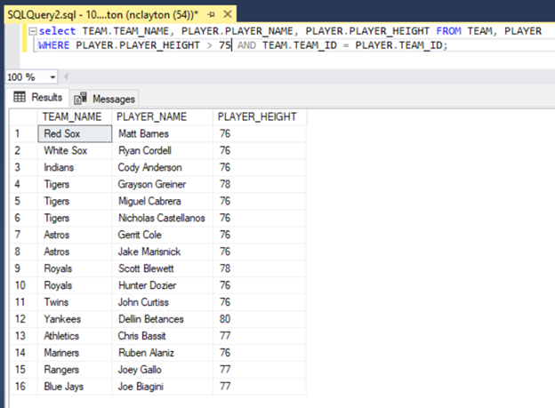
USE CASE # 1: Display player name, height, and team name of all players over 6ft 3in tall.

Slide 35
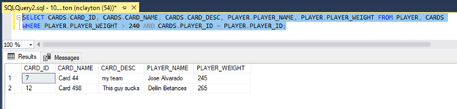
Use Case # 2: Display all cards of players who are over 240lbs.

Slide 36
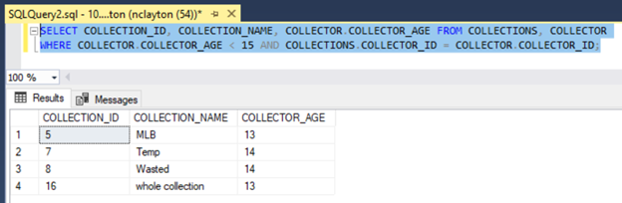
Use Case # 3: Display all collections owned by a collector under the age of 15.

Slide 37
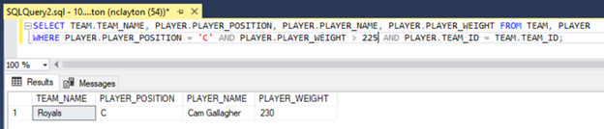
Use Case # 4: Display all catchers who are over 225lb and their team name.

Slide 38
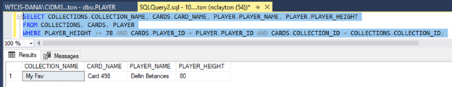
Use Case # 5: Display all cards and the collections the card belongs to of players who are 6’6 or taller.

Slide 39
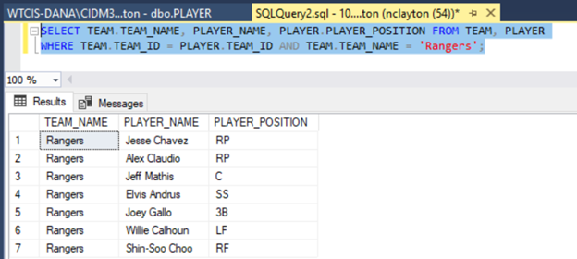
Use Case #6: Display all player’s names and positions who play for the Texas Rangers.

Slide 40
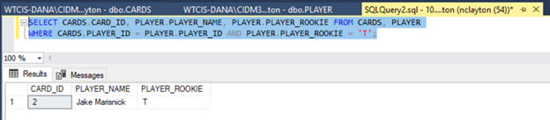
Use Case #7: Display all cards of players who are rookies.

